Slide 1
Student Spending Behavior Analysis

Slide 2
Objective
To analyze how students spend their money.
To identify major spending categories.
To understand saving habits.

Slide 3

Data Collection
Data collected using Google Forms
Total responses: 50
Target audience: Students

Slide 4
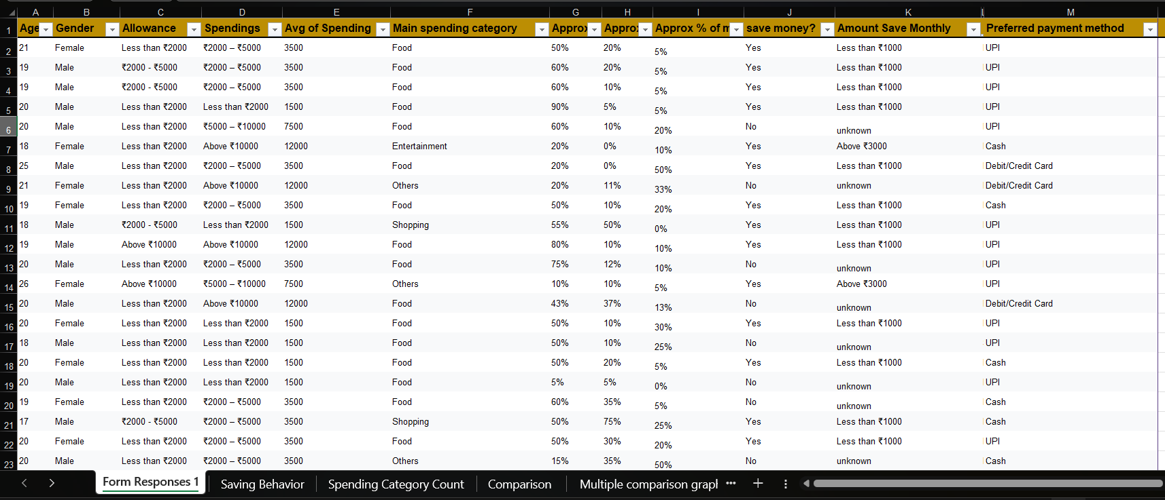
Dataset Overview
Age
Gender
Monthly allowance
Spending
Category
Savings

Slide 5
Data Cleaning
Removed missing values
Standardized text (Food, UPI etc.)
Converted ranges into numerical values
Removed duplicates
Converted Percentage data type

Slide 6


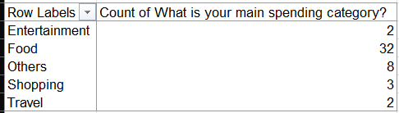

Analysis (Pivot Tables)
Saving Behavior
Spending categories
Payment methods
Used pivot tables to analyze data

Slide 7
Spending category
Allowance vs spending

Slide 8
Payment method

Slide 9
Key Insights
UPI is the most used payment method
Discounts influence spending
Some students don’t save money
Most students spent on food

Slide 10
Business Recommendations
Food brands can target students
Offer discounts to attract users
Promote digital payments
Encourage saving awareness

Slide 11
Conclusion
Successfully analyzed student spending behavior
Identified patterns and trends
Provided useful business insights

